Slide 1
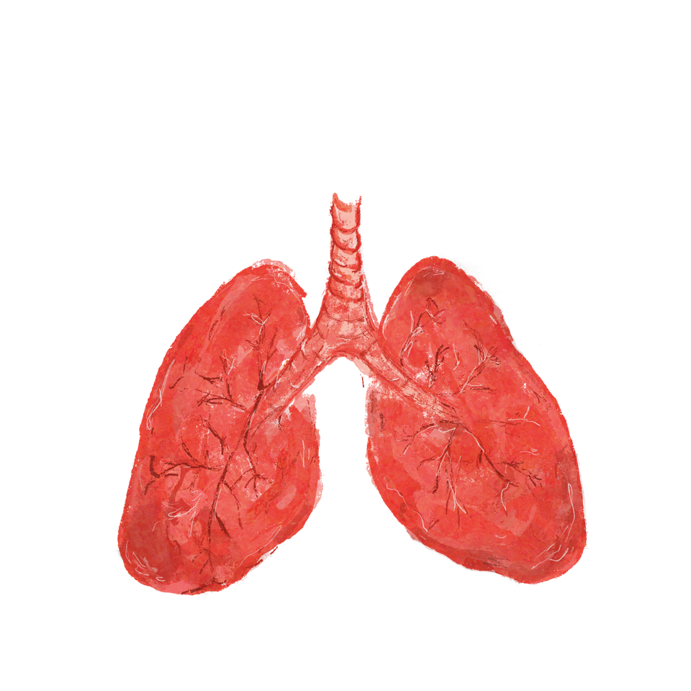
Lung Cancer Awareness Month
1st to 30th November 2022

Slide 2
Ruth Strauss Foundation
In early 2018 Ruth Strauss, wife of former England cricket captain Sir Andrew Strauss, was diagnosed with a terminal lung cancer that affects non-smokers. Ruth died in December 2018; she was 46 years old and mother to two children, then aged 10 and 13.

Slide 3
Our Mission
^{OUR MISSION HAS A DUAL FOCUS:}
^{Our Family Mission}
To ensure that every family with a child facing the death of a parent is offered the professional emotional support they need to prepare the family for the future.
Our Non-Smoking Lung Cancer Mission
To facilitate collaboration and influence research in the fight against non-smoking lung cancers, so that together we find the causes sooner and improve outcomes.
- The work the Ruth Strauss Foundation is doing around non-smoking lung cancers -

Slide 4
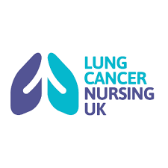
Our Scientific Advisory Group
^{Dr. Martin Forster}
^{Chair}
Vicki Anderson and Peter Barton
^{Scientific Advisors}
^{Prof. Andrew Nicholson}
^{Scientific Advisor}
^{Dr. Sandra Strauss}
^{Trustee & Scientific Advisor}
https://ruthstraussfoundation.com/about-us/#our-people
- The work the Ruth Strauss Foundation is doing around non-smoking lung cancers -

Slide 5
The facts: non-smoking lung cancers (NSLC)
1. There are around 48,500 new lung cancer cases in the UK each year, that’s around 130 people each day.
2. Around 15% of lung cancers are in those who have never smoked and this number is increasing, especially in younger people and women.
3. Nearly 6,000 people die of NSLC each year, greater than the numbers who die of cervical cancer (~5200), leukemia (~4500), ovarian cancer (~4200).
4. 8th most common cause of cancer-related death in the UK and the 7th most prevalent cancer in the world.
5. Late-stage diagnosis rises to nearly 90% in NSLC according to data from patient organisations.
6. Over 57% of lung cancers are diagnosed at stage 3 or 4​, which is too late for curative treatment.
7. One in five cancers are missed on chest X-rays​ “as chest X-rays are difficult to interpret” but it is the “recommended first test to assess whether a patient may have lung cancer”.​
8. 16% of people diagnosed with a lung cancer survive for 5 years or more. Lung cancer survival has not shown much improvement in the last 40 years in the UK.
- The work the Ruth Strauss Foundation is doing around non-smoking lung cancers -
Notes:
CRUK Lung cancer statistics | Cancer Research UK accessed 10/11/22
Cufari et al. Increasing frequency of non-smoking lung cancer: Presentation of patients with early disease to a tertiary institution in the UK. Eur J Cancer. 2017
Bhopal et al. Journal of the Royal Society of Medicine, 2019 Vol 112(7) 269-271
Bhopal et al. Journal of the Royal Society of Medicine, 2019 Vol 112(7) 269-271
ALK +UK & EGFR +UK patient survey 2020
Royal College of Pathologists, National Lung Cancer Audit, annual report, 2018
Missed detection of lung cancer on chest X-rays of patients being seen in primary care Independent report by the Healthcare Safety Investigation Branch October 2021​
CRUK Lung cancer statistics | Cancer Research UK accessed 10/10/22

Slide 6
How can you as a primary care professional support early diagnoses of all lung cancers?
Recognise that those with a non-smoking history can get lung cancers
Recognise that the profile of those with non-smoking lung cancer is often younger, more likely to be a woman, and won't always have the symptom of a persistent cough, as the cancer is more likely to be adenocarcinomas which grow in the outer part of the lung, which means the symptoms are unlikely to be noticeable at an early stage (i)
Recognise that patients who are non-smokers are more unlikely to consider their symptoms to need investigating for lung cancers due to the strong correlation between smoking history and lung cancers and may put their symptoms down to other causes (i)
Ask patients about other risk factors such as passive smoking, asbestos exposure, and exposure to environmental pollutants (ii)
Don't over reassure patients, and use your own clinical judgment when patients do not fall into the two-week urgent referral pathway, involving patients in the decision making
Consider the use of CT scans in a patient who has a clear CXR, but symptoms persist, c25% of CXR are normal in those who have lung cancer (iii)
Validate patient's help-seeking behaviour (iv)
- The work the Ruth Strauss Foundation is doing around non-smoking lung cancers -
Notes:
(i) Lung cancer symptom appraisal, help‐seeking and diagnosis – rapid systematic review of differences between patients with and without a smoking history - Os - 2022 - Psycho-Oncology - Wiley Online Library
(ii) Evidence for a genetical contribution to non-smoking-related lung cancer. - Abstract - Europe PMC
(iii) The role of imaging in the diagnosis of lung cancer in primary care - White Rose eTheses Online
(iv) Promoting early diagnosis and recovering from the COVID-19 pandemic in lung cancer through public awareness campaigns: learning from patient and public insight work | BMJ Open Respiratory Research

Slide 7
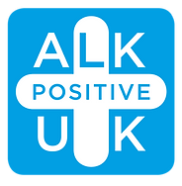
Watch See Through the Symptoms campaign video & visit RSF website

Slide 8
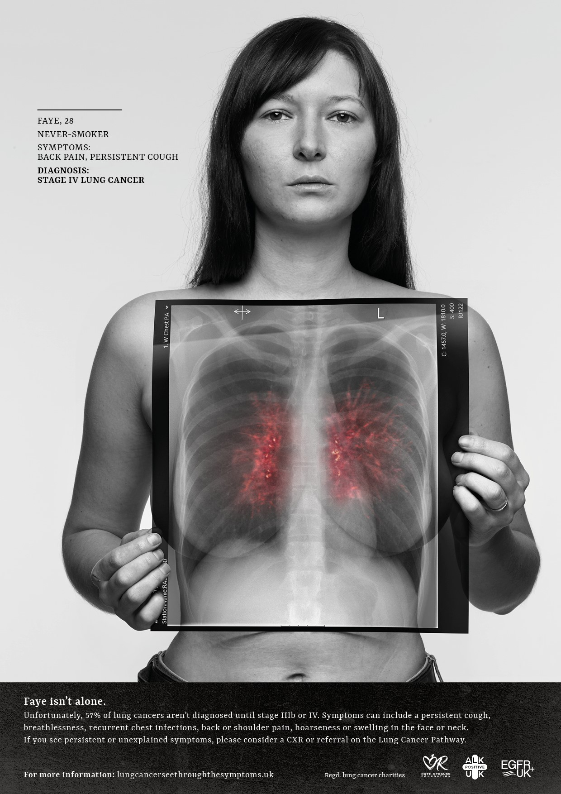
What are we doing
^{See Through the Symptoms}
LCNUK - The work the Ruth Strauss Foundation is doing around non-smoking lung cancers -

Slide 9
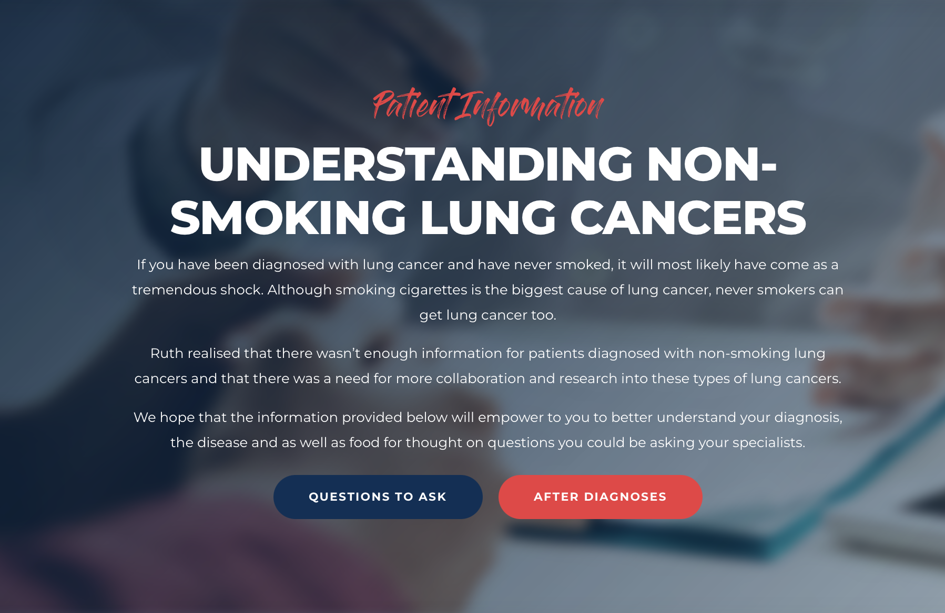
Visit RSF website for information on non-smoking lung cancers
https://ruthstraussfoundation.com/non-smoking-lung-cancer/

